Slide 1
Compiler Principle
Prof. Dongming LU
Mar. 10th, 2025

Slide 2
Content
INTRODUCTION
LEXICAL ANALYSIS
PARSING
ABSTRACT SYNTAX
SEMANTIC ANALYSIS
ACTIVATION RECORD
TRANSLATING INTO INTERMEDIATE CODE
OTHERS

Slide 3
3 Parsing

Slide 4
3.4 USING PARSER GENERATORS

Slide 5
Yacc (“Yet another compiler-compiler”)
A classic and widely used parser generator
The task of constructing LR(1) or LALR(1) is automatic

Slide 6
The Yacc Specification
Three sections separated by %% marks
parser declaration
%%
grammar rules
%%
programs
Parser declaration: a list of N, T and so on
Grammar rules: production of the form
exp : exp PLUS exp { semantic action }
Programs: ordinary C code usable from the semantic action

Slide 7
An Example
P → L
S → id := id
S → while id do S
S → begin L end
S → if id then S
S → if id then S else S
L → S
L → L ; S
GRAMMAR 3.30

Slide 8
An Example
%{
Int yylex(void)
Void yyerror(char *s) { EM_error(EM_tokPos, “%s”,s)}
%}
% token ID WHILE BEGIN END DO IF THEN ELSE SEMI ASSIGN
% start prog
%%
prog: stmlist
stm: ID ASSIGN ID
| WHILE ID DO stm
| BEGIN stmlist END
| IF ID THEN stm
| IF ID THEN stm ELSE stm
stmlist: stm
| stmlist SEMI stm
Semantic Actions are omitted
Yacc version of Grammar 3.0

Slide 9
CONFLICTS
shift-reduce conflict
Resolved using shift by default in Yacc
reduce-reduce conflict
Resolved using the rule appears early in the grammar
state 17: shift/reduce conflict
(shift ELSE, reduce 4)
stm : IF ID THEN stm.
stm : IF ID THEN stm. ELSE stm
ELSE shift 19
. Reduce by rule 4
shift-reduce conflicts
are acceptable
From: Figure3.32 LR states for Grammar 3.30

Slide 10
PRECEDENCE DIRECTIVES
Ambiguous grammars are still be useful if finding ways to resolve the conflict.
An example
E→id
E→num
E→E*E
E→E/E
E→E+E
E→E-E
E→( E )
Highly ambiguous
Many conflicts in LR(1) parsing table

Slide 11
PRECEDENCE DIRECTIVES
E→ E * E . +
E→ E. + E (any)
Bind * tighter than +, reduce instead of shift.
E→ E + E . +
E→ E. + E (any)
Make + left-associative, reduce instead of shift.

Slide 12
PRECEDENCE DIRECTIVES
Yacc uses precedence directives to resolve this class of shift-reduce conflicts
% nonassoc EQ NEQ
% left PLUS MINUS
% left TIMES DIV
% right EXP
E→ E * E . +
E→ E. + E (any)
The precedence declarations give priority to Token
The priority of rule is given by the last token

Slide 13
PRECEDENCE DIRECTIVES
%{ declarations of yylex and yyerror %}
%token INT PLUS MINUS TIMES UMINUS
%start exp
%left PLUS MINUS
%left TIMES
%left UMINUS
%%
exp : INT
| exp PLUS exp
| exp MINUS exp
| exp TIMES exp
| MINUS exp %prec UMINUS
−6 * 8 is parsed as (−6) * 8, not −(6 * 8)
The token UMINUS is never returned by the lexer.
The directive %prec UMINUS gives the rule exp::= MINUS exp the highest precedence

Slide 14
Syntax Versus Semantics
%token ID ASSIGN PLUS MINUS AND EQUAL
%start stm
%left OR
%left AND
%left PLUS
%%
stm : ID ASSIGN ae
| ID ASSIGN be
be : be OR be
| be AND be
| ae EQUAL ae
| ID
ae : ae PLUS ae
| ID
be : ID
ae: ID
Conflict!
defer this analysis until the "semantic" phase of the compiler
S → id := E
E → id
E → E & E
E → E = E
E → E + E

Slide 15
3.5 ERROR RECOVERY

Slide 16
RECOVERY USING THE ERROR SYMBOL
Local error recovery mechanisms
Adjusting the parse stack and the input at the point where the error was detected in a way that will allow parsing to resume.
Yacc parser generator
Uses a special error symbol to control the recovery process.

Slide 17
RECOVERY USING THE ERROR SYMBOL
exp → ID
exp → exp + exp
exp → ( exps )
exps → exp
exps → exps ; exp
exp → ( error )
exps → error ; exp
These are called synchronizing tokens
if a syntax error is encountered in the middle of an expression, the parser should skip to the next semicolon or right parenthesis and resume parsing.

Slide 18
1
S → .exp
exp → .ID
exp →. exp + exp
exp →. ( exps )
exp → .( error )
2
3
exp
+
exp →exp +. exp
exp → .ID
exp →. exp + exp
exp →. ( exps )
exp → .( error )
S → exp.
exp →exp .+ exp
ID
(
5
ID
ID
4
(
(
exp → ID.
7
exp
+
exp → ( .exps )
exp → (. error )
exps → .exp
exps → .exps ; exp
exps → .error ; exp
exp → .ID
exp →. exp + exp
exp →. ( exps )
exp → .( error )
+
ID
6
exp →exp + exp.
exp →exp .+ exp
exp
exps → exp.
exp →exp. + exp
9
exps
)
exp → ( exps ).
+
8
exp → ( exps. )
exps → exps. ; exp
11
;
exps → exps ; .exp
exp → .ID
exp →. exp + exp
exp →. ( exps )
exp → .( error )
(
10
12
error
exps → error ; .exp
exp → .ID
exp →. exp + exp
exp →. ( exps )
exp → .( error )
exp → (error. )
exps → error .; exp
exp
13
)
;
14
exps → error ; exp.
exp →exp .+ exp
exp → (error ) .

Slide 19
RECOVERY USING THE ERROR SYMBOL
error is considered a terminal symbol.
When the LR parser reaches an error state, it takes the following actions:
Pop the stack (if necessary) until a state is reached in which the action for the error token is shift.
Shift the error token.
Discard input symbols (if necessary) until a lookahead is reached that has a nonerror action in the current state.
Resume normal parsing.

Slide 20
Stack | Input | action
1 | (a++;b)$ | S4
14, ( | a++;b)$ | s5
145, (a | ++;b)$ | r
146, (e | ++;b)$ | s3
1463, (e+ | +;b)$ | error
14, ( | +;b)$ | s12
1412, (error | ;b)$ | s10
141210, (error; | b)$ | s5
1412105, (error; b | )$ | r
14121013, (error; e | )$ | r
148, (exps | )$ | s9
1489, (exps) | $ | r
12,e | $ | r
S → exp
exp → ID
exp → exp + exp
exp → ( exps )
exps → exp
exps → exps ; exp
exp → ( error )
exps → error ; exp
input tokens: (a++;b)$

Slide 21
GLOBAL ERROR REPAIR
Global error repair : finds the smallest set of insertions and deletions that would turn the source string into a syntactically correct string, even if the insertions and deletions are not at a point where an LL or LR parser would first report an error.
Burke-Fisher error repair : single-token insertion, deletion, or replacement at every point that occurs no earlier than K tokens before the point where the parser reported the error.

Slide 22
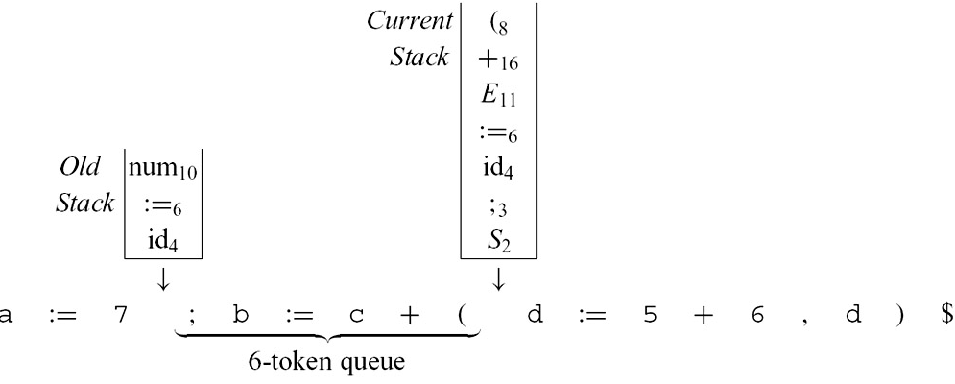
GLOBAL ERROR REPAIR
The advantage of this technique:
The LL(k) or LR(k) (or LALR, etc.) grammar is not modified at all (no error productions)
Nor are the parsing tables modified.
The parsing engine, which interprets the parsing tables, is modified.

Slide 23
The end of Chapter 3(4)

